Slide 1
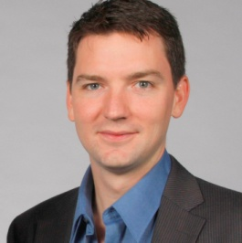
Patrick Baynes
Co-Founder, PeopleLinx
Formerly of LinkedIn Corp.
PeopleLinx
Helps optimize employee LinkedIn profiles and usage through
software and high touch point services.
LinkedIn for Lawyers and Firms

Slide 2
LinkedIn
LinkedIn is
Global. The world’s largest and most active professional network.

Slide 3
LinkedIn
LinkedIn is
Growing. Adding over 3M members per month - Over 181M today.

Slide 4
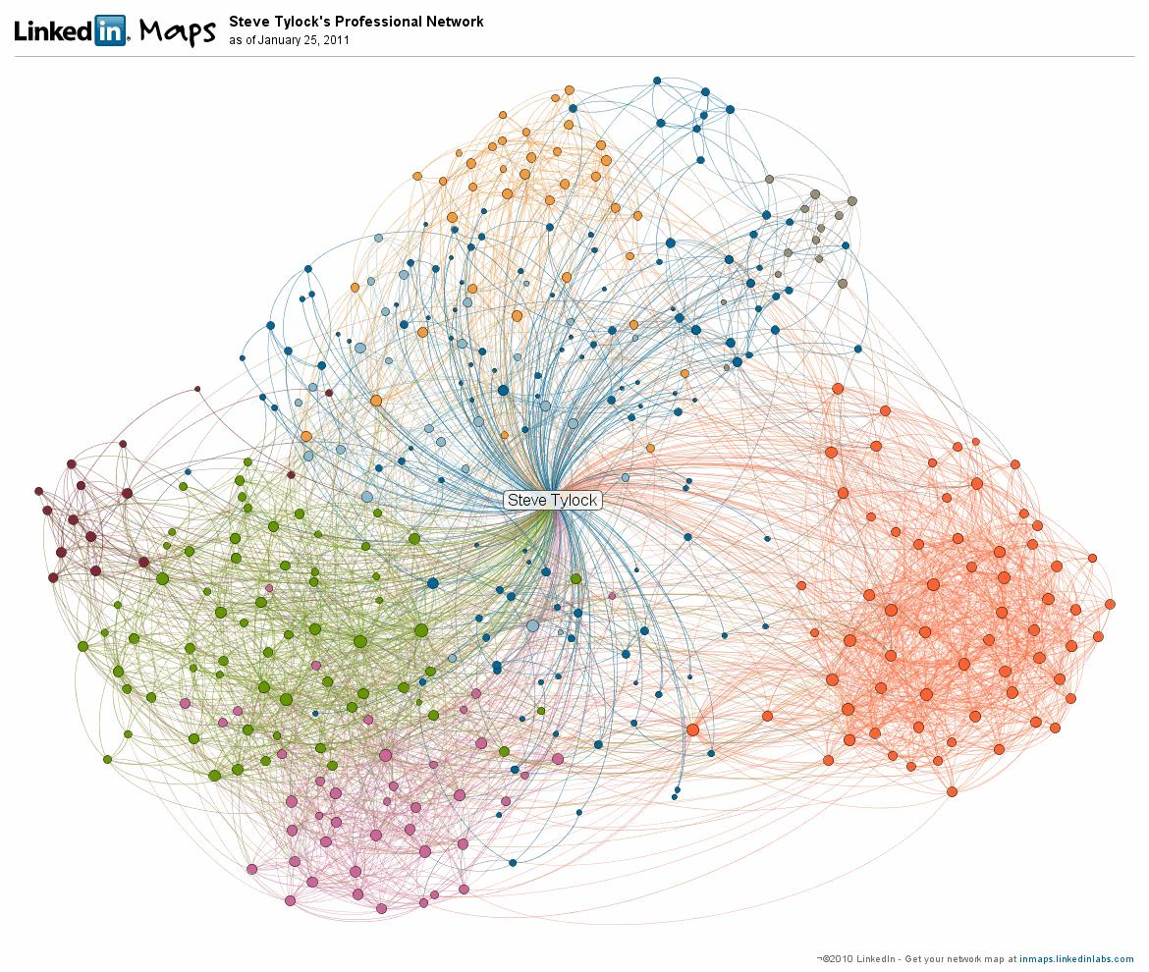
LinkedIn
LinkedIn is
34,000+ law practices. 1.5+ million lawyers.

Slide 5
LinkedIn
LinkedIn is
A tremendous sales and relationship channel opportunity. 50K+ General Counsel

Slide 6
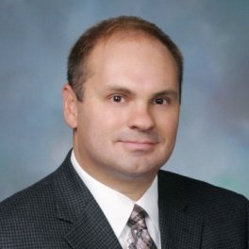
LinkedIn is a Business Development Channel
Craig Falls
Antitrust Associate
The power of your actions

Slide 7
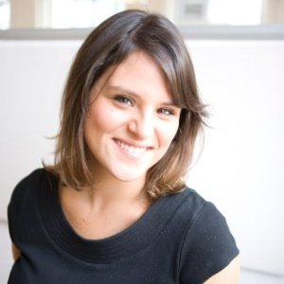
LinkedIn is a Business Development Channel
Liana Guzman
Marketing Director
The power of your story

Slide 8
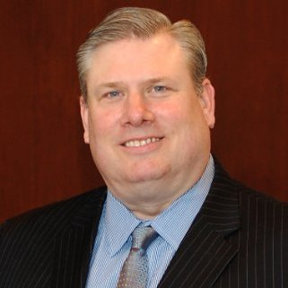
LinkedIn is a Business Development Channel
Jeff Taylor
Former SVP
The power in being accessible

Slide 9
LinkedIn
Today, your clients and prospects have access to more information than ever before about your:
Firm
Services
Competitors
People / Personal brand
Today, you have access to more information about your clients and prospects than ever before:
Where they’ve worked
How long they’ve been there
Where they went to school
What they are interested in
How you are connected
Real time personal and company updates

Slide 10
LinkedIn
Law firms are using LinkedIn to:
Recruit talent
Get closer to clients
Research opportunities
Promote events
Distribute content
Individual attorneys are using LinkedIn to:
Increase their profile and visibility
Connect with clients and partners
Stay in touch with personal and business relationships
Position themselves for inbound business
Research and meeting preparation

Slide 11
Getting Started
Social Business Adoption Spectrum
Discovery
Compliance
Engagement

Slide 12
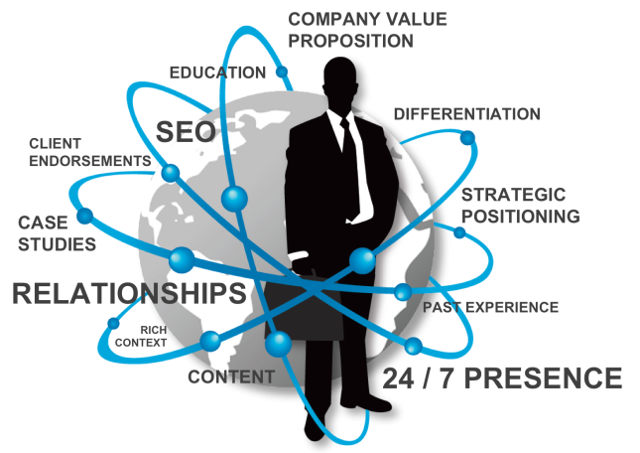
Getting Started
After

Slide 13
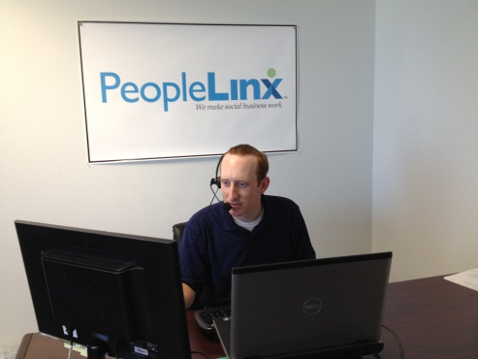
Company Background
PeopleLinx is
A social business training application
Supported by 1-on-1 coaching
[Software]
[Services]
[Sales]

Slide 14
Company Background
Private, 1:1 shared screen training
Profile optimization and positioning
Marketing and content sharing
Prospecting and lead generation

Slide 15
Contact
Patrick Baynes
Co-Founder, PeopleLinx
pbaynes@peoplelinx.com
267.773.7281
1835 Market Street
Suite 2705
Philadelphia, PA 19103
linkedin.com/company/peoplelinx
twitter.com/peoplelinx

