Slide 1
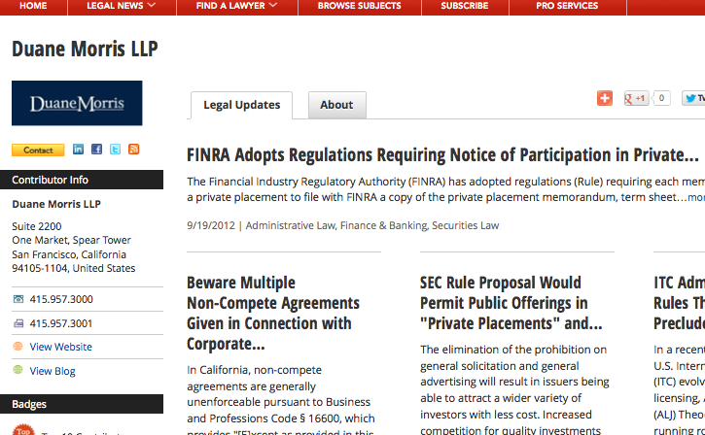
Content Hosted on JDSupra.com

Slide 2

Alerts, articles, blog posts…

Slide 3
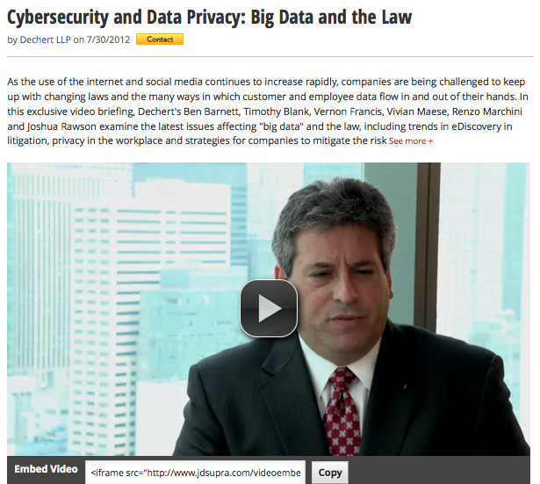
…and (really interesting) video.

Slide 4
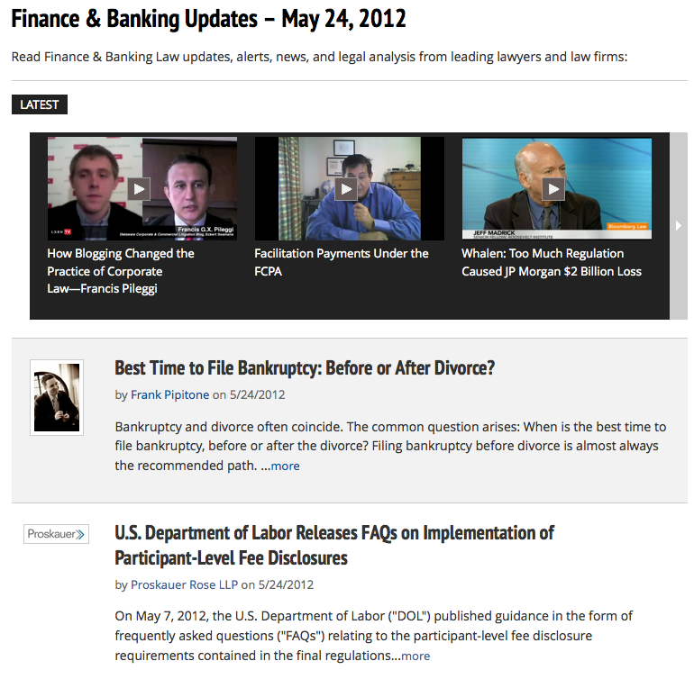
Direct visits & Google visibility

Slide 5
Distribution: Social Content
Your expertise the center of attention
Listen, learn, utilize
Other people’s
communications
& networking
Intelligence:
the big picture
Your communications,
your network
Connect with peers & others

Slide 6
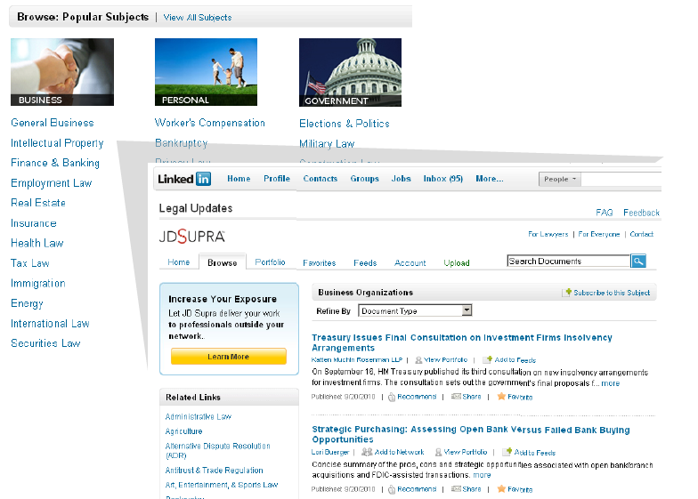
Distribution: Legal Updates on LinkedIn

Slide 7
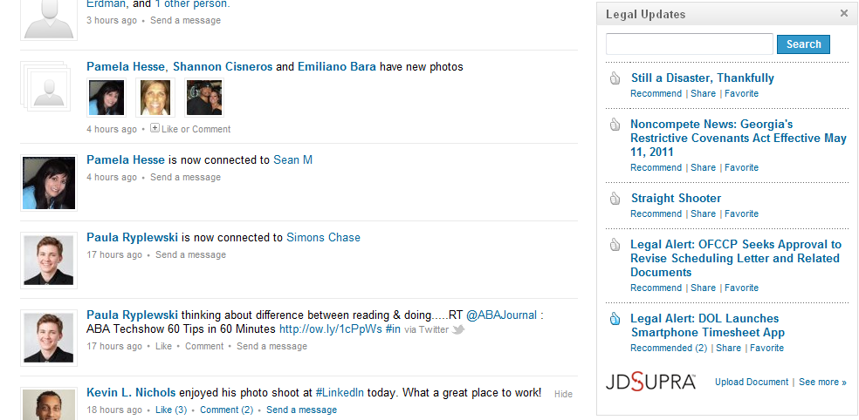
Distribution: Legal Updates on LinkedIn

Slide 8

Distribution: Subject-Specific e-Mails

Slide 9
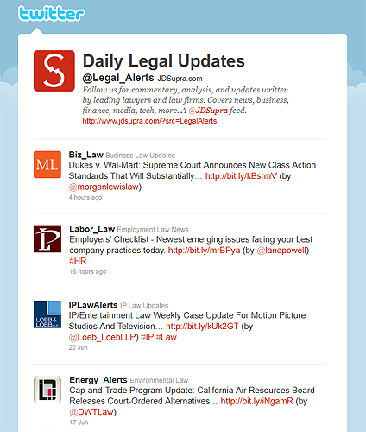
Distribution: Twitter News Feeds for Professionals

Slide 10
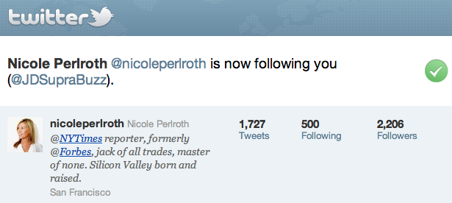
Subscribers: Media

Slide 11
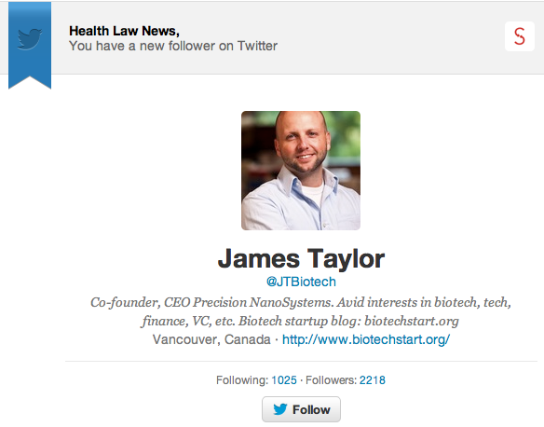
Subscribers: Execs

Slide 12
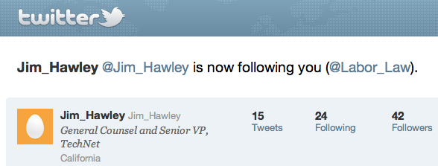
Subscribers: GC

Slide 13
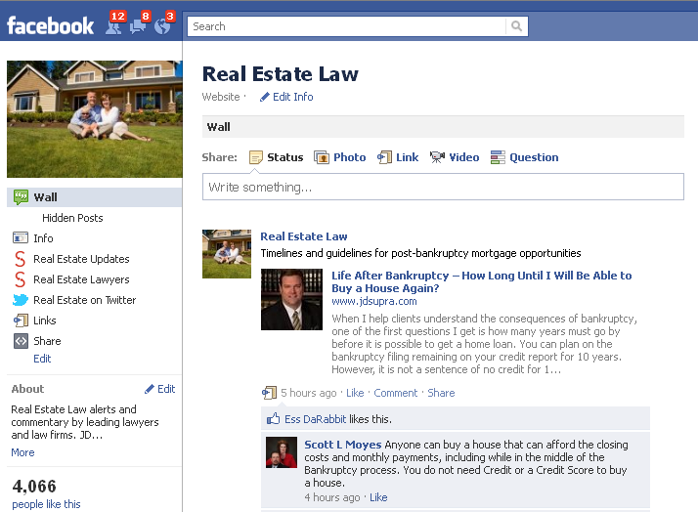
Distribution: Facebook Practice-Specific Pages

Slide 14
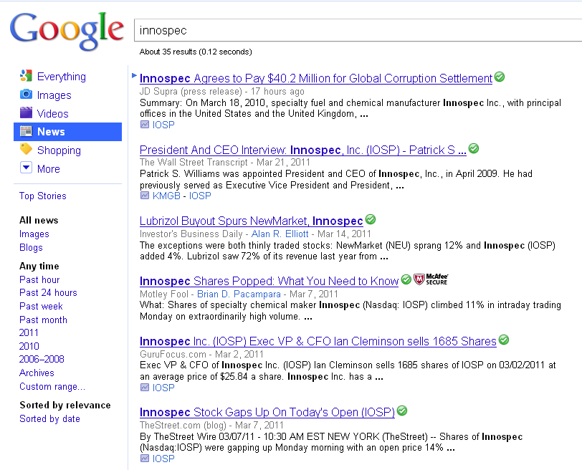
Distribution: Google News
We deliver it to Google News & Google Finance

Slide 15
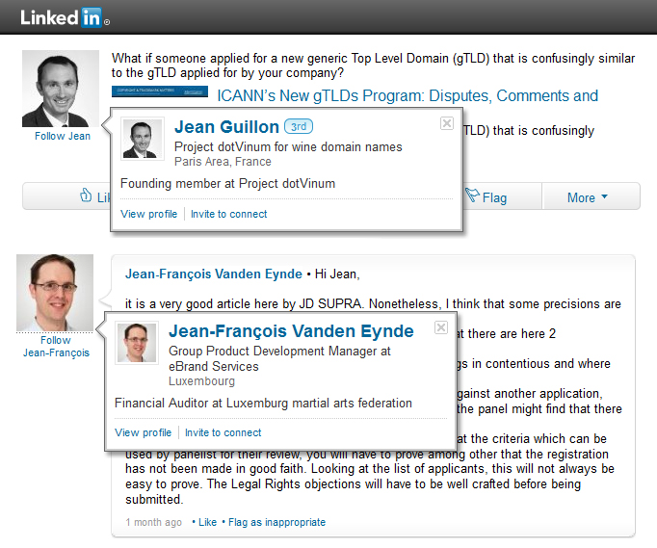

Corporate Executives on Social Media
Notes:
Discussion here – see what you can do to capture….

Slide 16
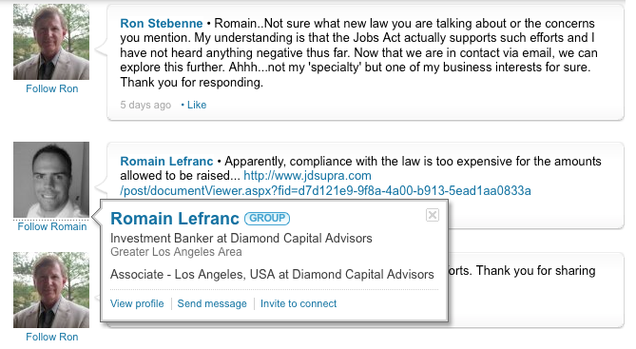

Corporate Executives on Social Media

Slide 17


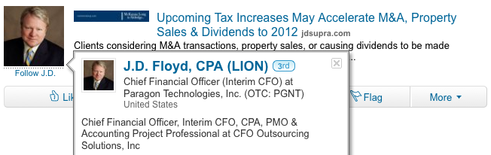
Corporate Executives on Social Media

Slide 18

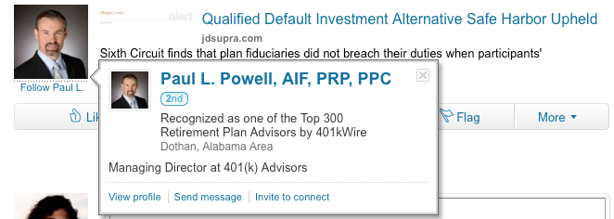
Corporate Executives on Social Media

Slide 19


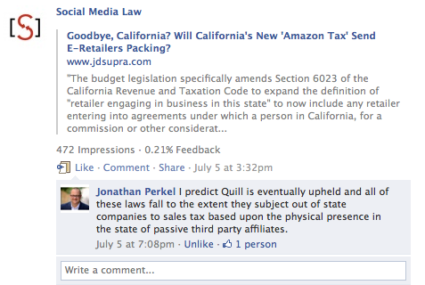
Corporate Executives on Social Media

Slide 20
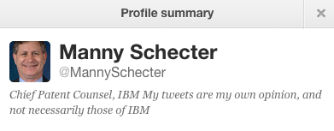
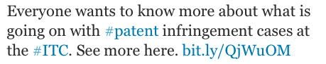

Corporate Executives on Social Media

Slide 21
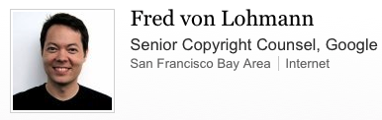
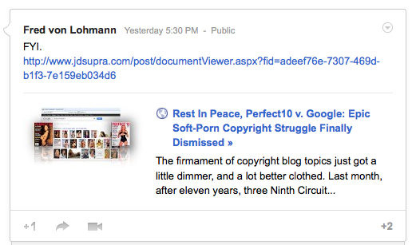

Corporate Executives on Social Media

Slide 22
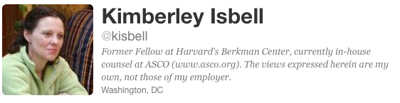


Corporate Executives on Social Media
Notes:
Reed Smith

Slide 23
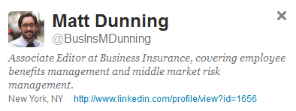


Editors & Journalists

Slide 24


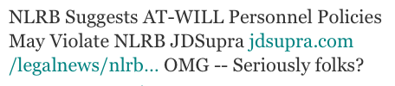
Editors & Journalists

Slide 25
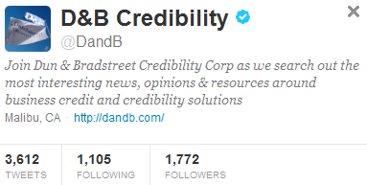

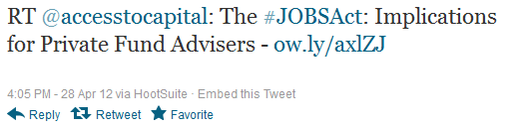
Corporate Editors & Journalists
Notes:
Bracewell

Slide 26


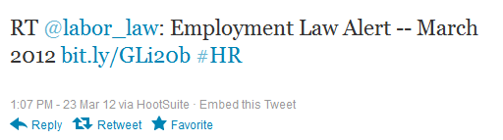
Industry Associations
Notes:
Ruskin

Slide 27
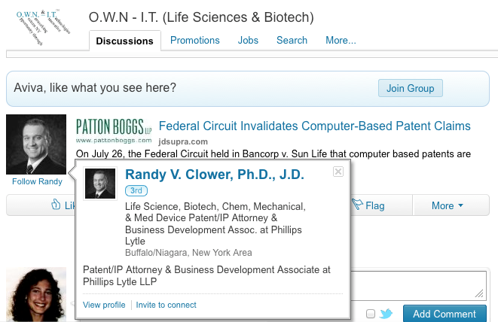

Attorneys at Other Firms

Slide 28
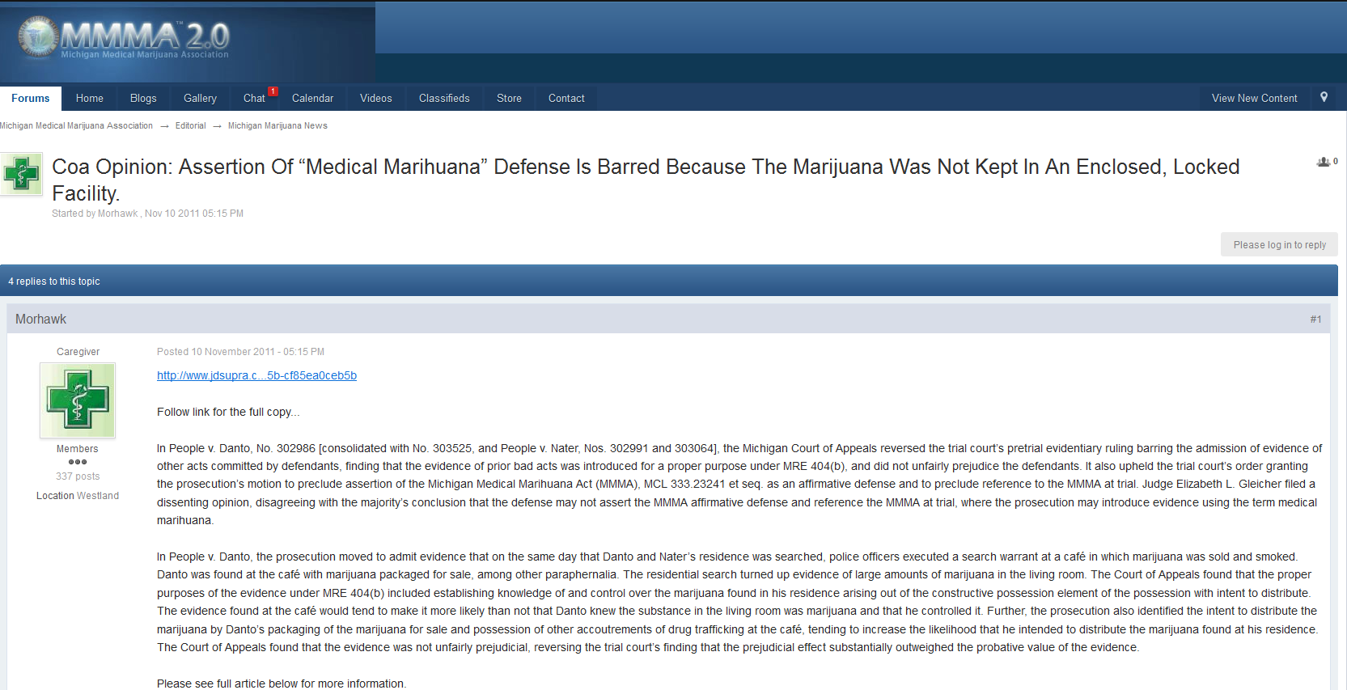

Community Sharing
Notes:
WNJ

Slide 29

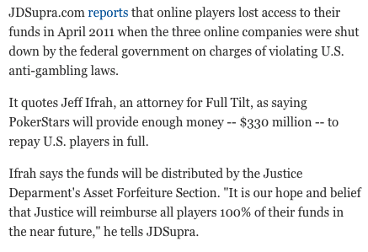

Media Pickup

Slide 30

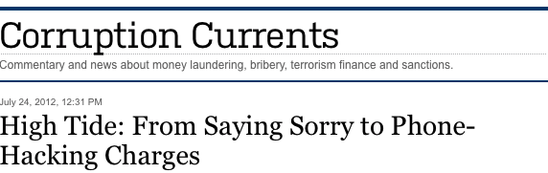




Media Pickup

Slide 31


Media Pickup

Slide 32
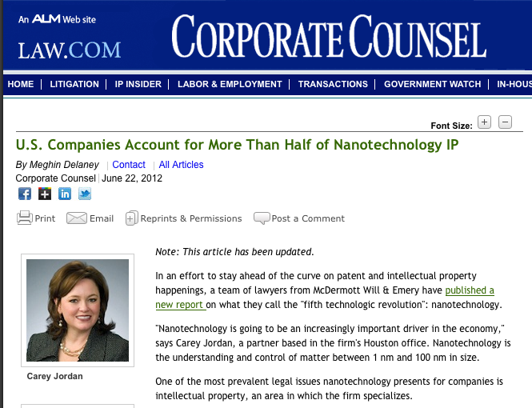

Media Pickup

Slide 33

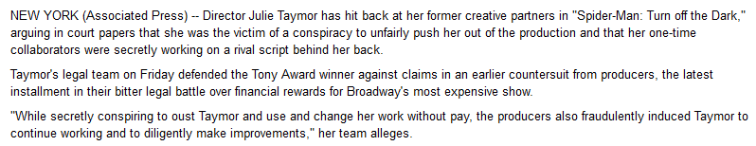

Media Pickup

Slide 34


Media Pickup: Industry Publications

Slide 35


Media Pickup: Industry Publications

Slide 36
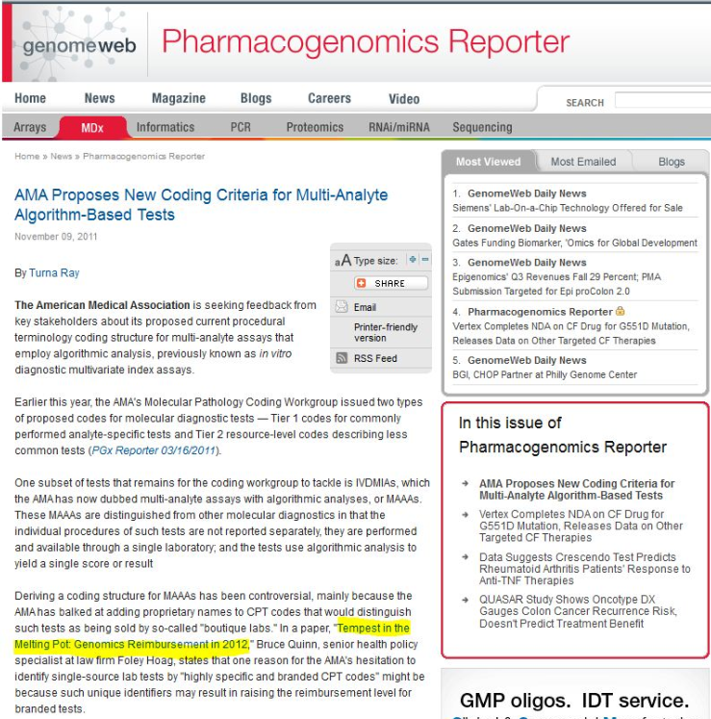
Media Pickup: Industry Publications
Notes:
http://www.techdirt.com/articles/20090508/0212134792.shtml

Slide 37
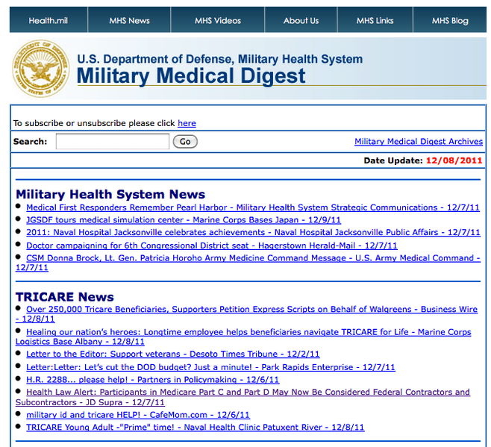

Media Pickup: Industry Publications
Notes:
Ober

Slide 38
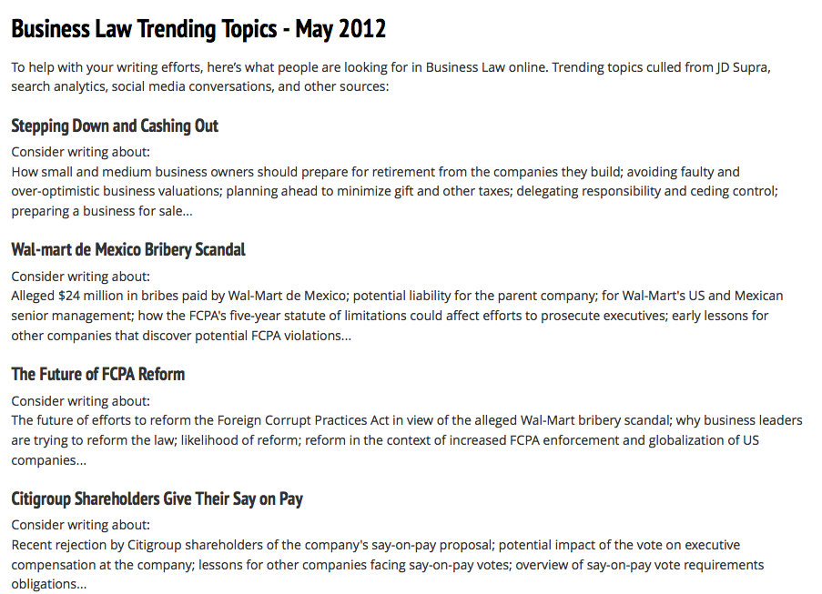
Editorial Support: Market Intelligence

Slide 39
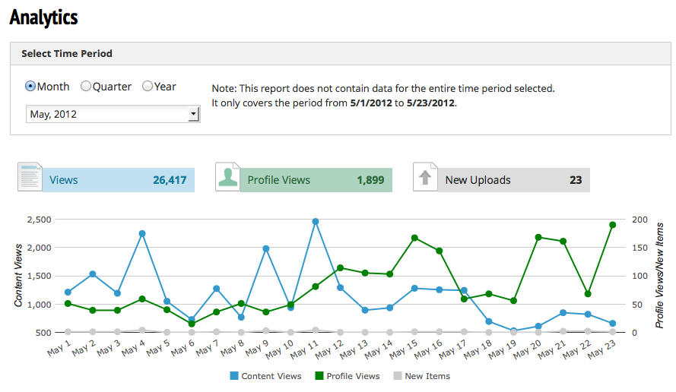
Analytics

Slide 40
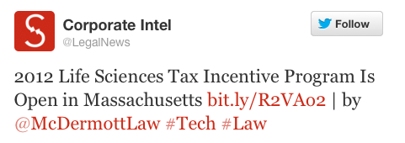

Help Growing Your Own Networks
We promote your firm’s own social media pages to our subscribers providing targeted visibility to grow your channels

Slide 41
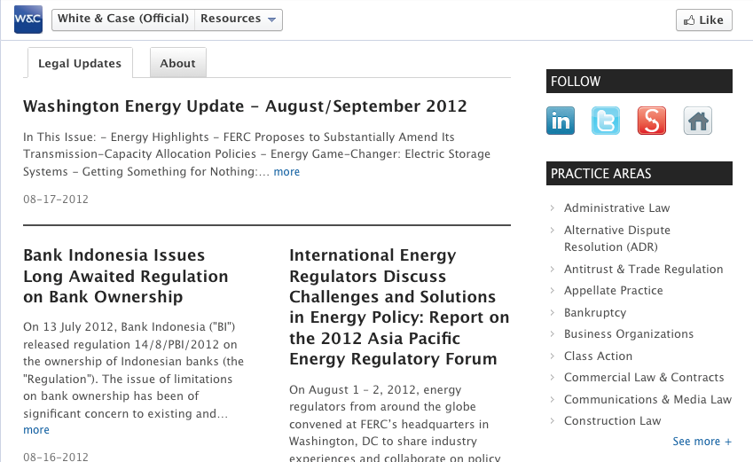

Help Updating Your Own Networks

Slide 42


Help Updating Updating Your Own Networks

Slide 43
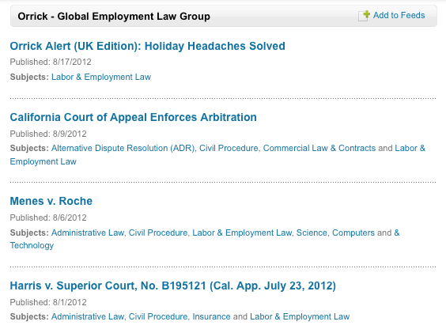
Help Updating Your Own Networks

Slide 44

































Am Law and More

Slide 45




































Corporate Readers

Slide 46

Media Visibility

